Slide 1
FY21 PROJECTED PROFITABILITY ANALYSIS
LOYOLA UNIVERSITY, NEW ORLEANS

Slide 2
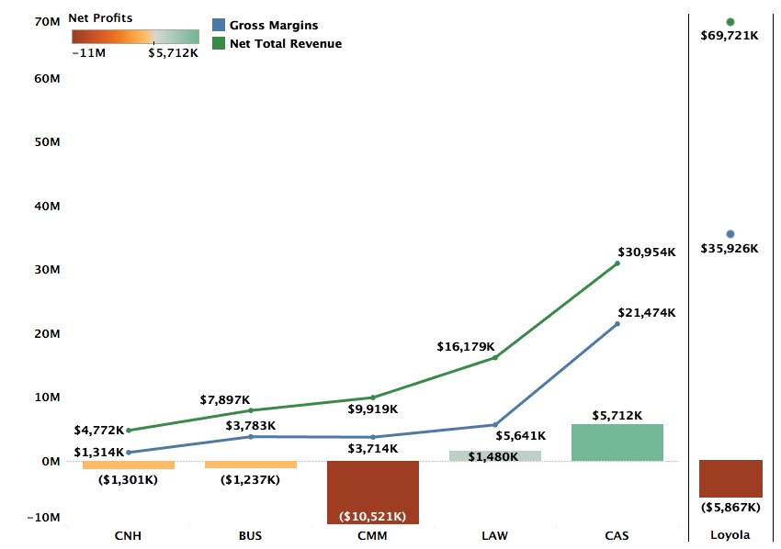
Profitability by College FY21 Projections

Slide 3
Profitability by Department (FY21 Projections)
Excluding Environment
Notes:
Accounting is projected to be positive. All other 14 departments continue to be loss making. – Add the note on Accounting

Slide 4
DEFINITIONS
Net Total Revenue (NTR): NTR includes revenue for courses taught by the faculty of a department across all three terms, distributed revenue for courses that do not belong to a specific department, and distribution of revenues from courses of programs like Study Abroad that do not have any assigned faculty.
Gross Margins (GM): GM = NTR – Direct Costs. Direct costs include salaries, operating costs, and fringe benefits.
Profitability = GM – Indirect Costs + Indirect Revenues. Indirect costs refer to administration costs, auxiliary costs, or college level costs distributed over departments of the specific college. Indirect revenues include auxiliary revenues, dorm revenues, and revenue from other sources.

Slide 5
Methodology FY21 Projections
FY21 Revenue Projections: Revenue projections are based on Fall 2020 enrollments and projected Spring retention rate. FY20 summer revenues are used as proxy for the FY21 summer term.
Direct Costs: Direct costs include salaries and operating costs from department budgets. FY20 fringe benefits are used as a proxy for FY21 fringe benefits.
Indirect Costs: Indirect costs in FY20 and FY21 have been higher than previous years and is reflected in department-level profitability. FY21 is also estimated to bring in lower Auxiliary revenues.

Slide 6
DEPARTMENTS WITH INCREASING LOSSES FROM FY19 TO FY21

Slide 7
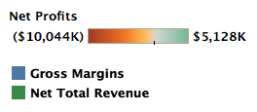
Music
GM for Music slipped into negative in FY20 and is projected to continue being negative in FY21
Music accounted for 9.76% of students in FY20, nearly 3 times the average size of a department
Music also has more than twice the directs costs of an average department at the university
However, NTR for Music is only slightly above the department avg of ~$2.1M in FY20 and ~$2.2M in FY21, suggesting a high discount rate

Slide 8
Music Industry
NTR and GM for Music Industry are projected to continue to decline in FY21
Music Industry accounts for 9.7% of students, nearly 3 times the average department
The projected decline of ~$900K in profits is led largely by a ~$800K decline in NTR
Less than proportionate revenues, given the size of the department, also signify a higher than average discount rate

Slide 9
Nursing
The declining trend in NTR is projected to continue for Nursing
The GMs are projected to decline at a higher rate than the revenues in FY21
Nursing has above average projected NTR - ~$2.9M compared to university avg of ~$2.2M in FY21. However, direct costs of ~$2.2M is more than double the average direct costs of ~$1.1M.

Slide 10
Theatre
The projected NTR and GM for FY21 are relatively constant compared to FY20 after a steep decline in FY20 from fY19
Indirect costs for Theatre are projected to increase from ~$1.3M in FY20 to ~1.5M in FY21
Auxiliary and Dorm revenues are projected to decrease from ~$650K to ~$500K

Slide 11
Psychology
Psychology accounted for 7.6% of all students in FY21 – that is 2.5 times the size of an average department.
Despite slight increase in revenues from FY19, Psychology’s losses increased because of greater indirect costs
At ~$2.8M, Psychology accounts for only 1.25 times the average department revenue, suggesting a higher than average discount rate.

Slide 12
Biology
Biology had 5.9% of all students in FY20 – roughly twice the size of an average department.
Its revenues are, however, proportionate to an average department suggesting higher than average discount rate
Increase in indirect costs and less than proportional increase in projected NTR is likely to result in even higher losses in FY21

Slide 13
Communication
Communication had an increase of ~33% in NTR from FY19 to FY20 but is projected to see a decline of ~7% in NTR in FY21
At 7.4% of all students, Communication is more than twice the size of an average department. However, its NTR in FY20 is only 1.5 times the size of an average department
Projected increase in losses are driven by consistently less than proportionate revenues and higher indirect costs

Slide 14
DEPARTMENTS WITH INCREASING REVENUES/DECLINING LOSSES

Slide 15
Chemistry
After a drop in NTR in FY20, Chemistry is projected to increase revenues in FY21
GM is projected to improve by $332K in FY21 with losses dropping by $164K
With 2.25% of all students in FY20, Chemistry had a slightly lower size than the average department. However, it’s NTR was just over half of the average department NTR. This suggests a higher than desirable discount rate.

Slide 16
Political Science
Political Science is projected to have better outcomes across the board in FY21
This is a direct result of increase in projected revenues by $153K and is projected to result in an overall decline of $73K in losses. Direct costs are projected to stay the same.
At 2.57% of all students, Political Science is 3/4th the size of an average department, but it’s NTR is only half that of an average department.

Slide 17
Management
Management’s NTR has not changed much from FY19 through the projected FY21
Management has 5.9% of all students at the university – roughly twice the size of an average department. However, it’s projected revenues of ~$3.3M in FY21 are only 1.5 times the revenues of an average department, suggesting a higher than average discount rate.

Slide 18
Marketing
Healthy projected increase in NTR for Marketing is likely to reduce the losses for the department to $60K.
Despite a projected increase in revenues, Marketing has lower than proportionate NTR because of slightly higher discount rates

Slide 19
Finance
Finance had a steep decline in NTR in FY20.
A slight increase in projected NTR is likely to improve the GM slightly and lower losses, but changes from FY20 to FY21 are projected to be minimal.
Finance is projected to only make ~33% of an average department’s NTR, even though with 2.27% of all students, it is 70% of the size of an average department

Slide 20
Loyola Institute for Ministry
Despite a slight increase in projected revenues , LIM is projected to have lower GM due to a small increase in direct costs
Like Finance, LIM is projected to post an NTR of ~25% of an average department. However, its direct costs are ~50% of the direct costs of an average department at the university.

Slide 21
Direct Costs to Revenue Ratio

Slide 22
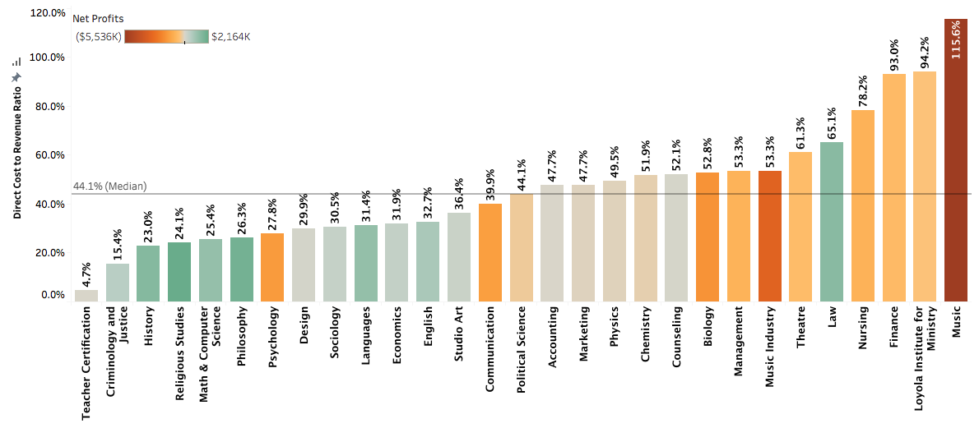
DCRR by Department (FY21 Projected)
Excluding Environment

Slide 23
Summary and Recommendations
Higher indirect costs and lower auxiliary revenues because of coronavirus crisis are reflected in losses of some departments.
But losses are largely driven by either high discount rates or high direct costs.
High discount rates reflect the discounts offered to students taking courses offered by specific departments. These students may or may not be part of the majors offered by the departments. As such, driving lower discount rates should be a university wide initiative.
A separate analysis of discount rates by majors can be provided for each department.
Departments with higher than median DCRR have higher than proportionate direct costs or lower than proportionate revenues or a combination of both. For these departments the focus needs to be three-fold: improve enrollment, reduce discount rates, and reduce costs.

Slide 24
Appendix (FY19 and FY20)

Slide 25
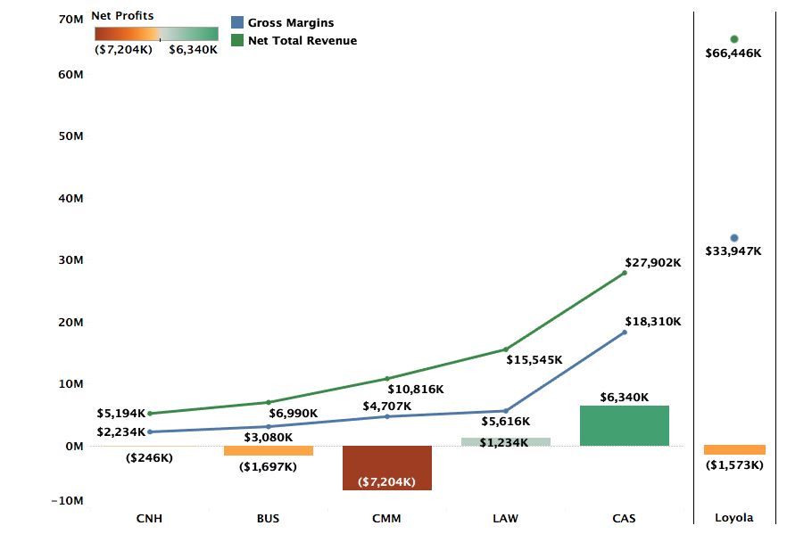
Profitability by College FY20 Actuals

Slide 26
Profitability by Department (FY20 Actuals)
Excluding Environment
Notes:
Departments like Teacher Certification and Studio art are small departments with low costs. They have +ve gross margins but higher profitability largely because of dorm revenue share which is divided by college and within college, the departments get equal share.

Slide 27
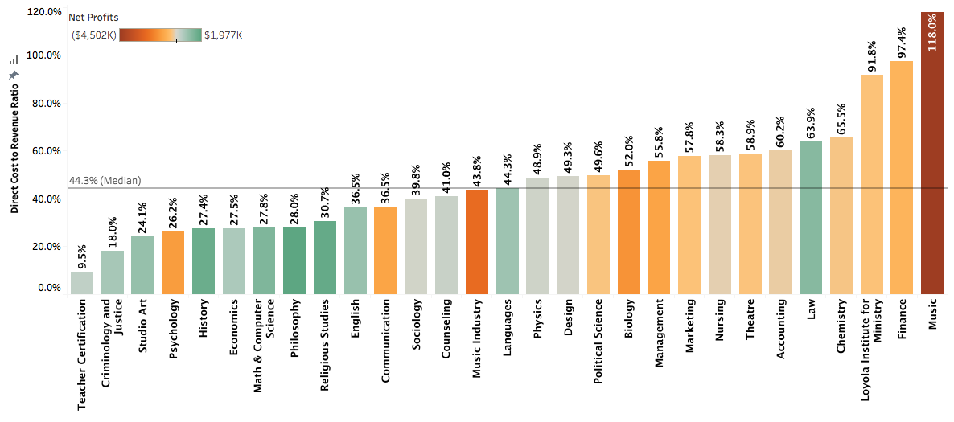
DCRR by Department (FY20 Actuals)
Excluding Environment

Slide 28
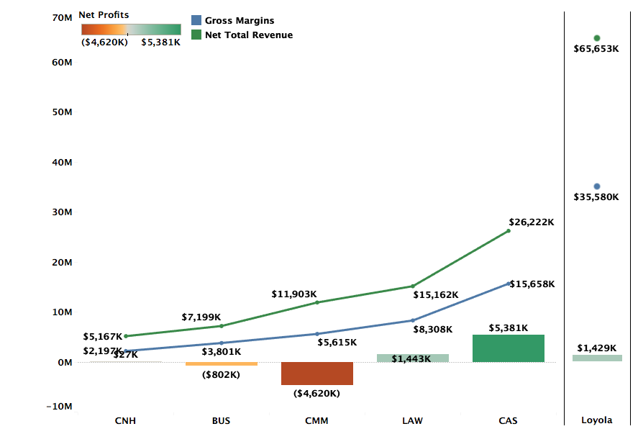
Profitability by College FY19 Actuals

Slide 29
Profitability by Department (FY19 Actuals)
Excluding Classical Studies and Environment
Notes:
Departments like Teacher Certification and Studio art are small departments with low costs. They have +ve gross margins but higher profitability largely because of dorm revenue share which is divided by college and within college, the departments get equal share.

Slide 30
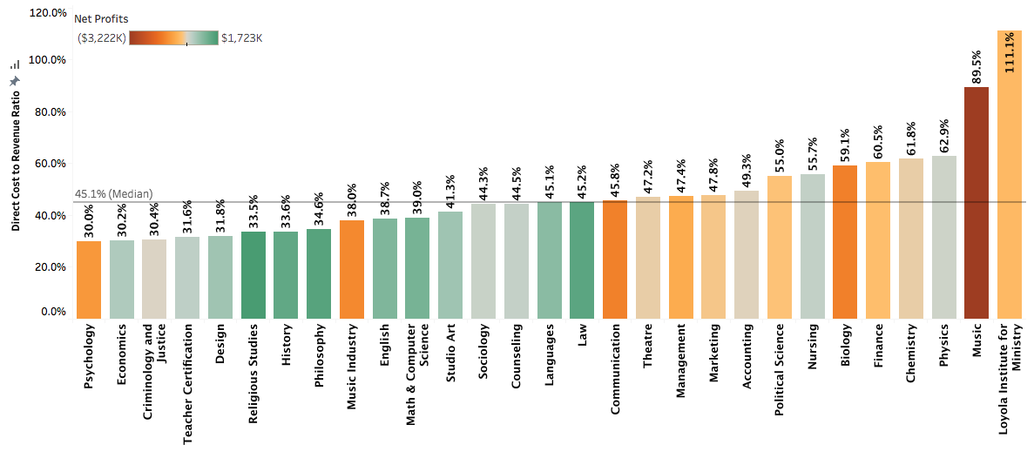
DCRR by Department (FY19 Actuals)
Excluding Classical Studies and Environment

